Slide 1
MIS
CHAPTER 14
EMERGING TRENDS, TECHNOLOGIES, AND APPLICATIONS
Hossein BIDGOLI

Slide 2
Chapter 14 Emerging Trends, Technologies, and Applications
l e a r n i n g o u t c o m e s
LO1 Summarize new trends in software and service distribution.
LO2 Describe virtual reality components and applications.
LO3 Discuss uses of radio frequency identification.
LO4 Summarize new uses of biometrics.
LO5 Explain new trends in networking, including wireless technologies and grid and cloud computing.

Slide 3
Chapter 14 Emerging Trends, Technologies, and Applications
l e a r n i n g o u t c o m e s (cont’d.)
LO6 Discuss uses of nanotechnology.

Slide 4
Trends in Software and Service Distribution
Recent trends in software and service distribution include:
  Pull and push technologies
  Application service providers

Slide 5
Pull and Push Technologies
Pull technology
  User states a need before getting information
  Entering a URL in a Web browser to go to a certain Web site
Push technology (Webcasting)
  Web server delivers information to users who have signed up for this service
  Supported by many Web browsers
  Also available from vendors
  Delivers content to users automatically at set intervals or when a new event occurs

Slide 6
Pull and Push Technologies (cont’d.)
Examples of push technology:
  “A newer version of Adobe Flash is available. Would you like to install it?”
  Research In Motion (RIM) offers a new BlackBerry push API
  Microsoft Direct Push from AT&T

Slide 7
Application Service Providers
Application service providers (ASPs)
  Provide access to software or services for a fee
Software as a service (SaaS), or on-demand software
  Model for ASPs to deliver software to users for a fee
  Software might be for temporary or long-term use
  Users don’t need to be concerned with new software versions and compatibility problems

Slide 8
Application Service Providers (cont’d.)
Users can also save all application data on the ASP’s server
  Software and data are portable
The SaaS model can take several forms:
  Software services for general use
  Offering a specific service
  Offering a service in a vertical market

Slide 9
Application Service Providers (cont’d.)
Advantages:
  Similar to outsourcing
    Less expensive
    Delivering information more quickly
Other advantages and disadvantages
Vendors:
  Google, NetSuite, Inc., and Salesforce.com

Slide 10
Virtual Reality
Goal of virtual reality (VR):
  Create an environment in which users can interact and participate as they do in the real world
VR technology
  Uses computer-generated, three-dimensional images to create the illusion of interaction in a real-world environment

Slide 11
Virtual Reality (cont’d.)
VR terms:
  Simulation
  Interaction
  Immersion
  Telepresence
  Full-body immersion
  Networked communication

Slide 12
Types of Virtual Environments
Egocentric environment
  User is totally immersed in the VR world
  Most common technology used with this environment is a head-mounted display (HMD)
Exocentric environment
  Data is still rendered in 3-D
  Users can only view it onscreen
  Main technology used in this environment is 3-D graphics

Slide 13
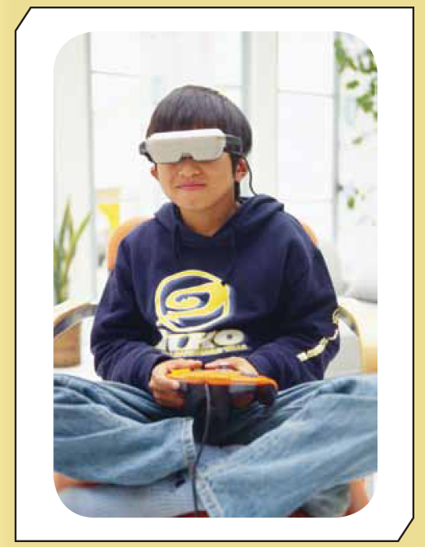
Exhibit 14.1
Egocentric VR Technologies

Slide 14
Components of a Virtual Reality System
Visual and aural systems
Manual control for navigation
Central coordinating processor and software system
Walker

Slide 15
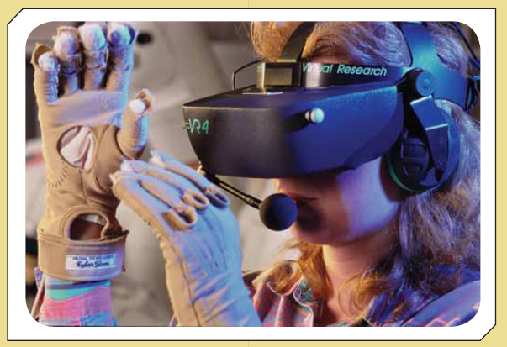
Exhibit 14.2
VR Components

Slide 16
CAVE
Cave automatic virtual environment (CAVE)
  Virtual environment consisting of a cube-shaped room in which the walls are rear-projection screens
CAVEs
  Holographic devices that create, capture, and display images in true 3-D form

Slide 17
CAVE (cont’d.)
People can enter CAVEs in other locations
  No matter how far away they are geographically
High-speed digital cameras capture one user’s presence and movements
  Then re-create and send these images to users in other CAVEs
Used for research in many fields:
  Archaeology, architecture, engineering, geology, and physics

Slide 18
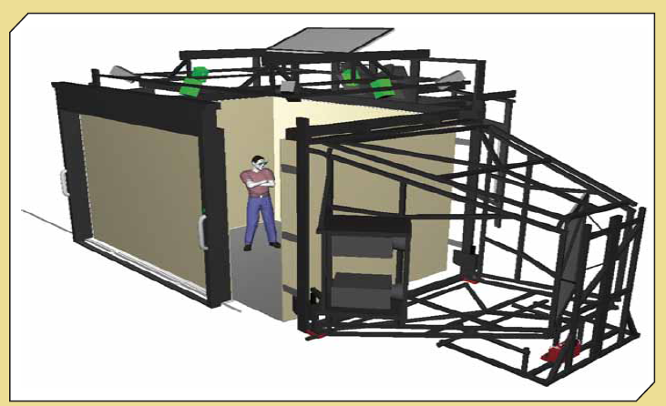
Exhibit 14.3
An Example of a CAVE

Slide 19
Virtual Reality Applications
Military flight simulations
Medicine for “bloodless” surgery
Entertainment industry
Will one day be used for user interfaces in information systems
Current applications:
  Applications for the disabled
  Architectural design

Slide 20
Virtual Reality Applications (cont’d.)
  Education
  Flight simulation
  Videoconferencing
  Group support systems

Slide 21
Obstacles in Using VR Systems
Not enough fiber-optic cables are currently available for a VR environment capable of re-creating a conference
Problems must be solved:
  Confusion between the VR environment and the real environment
  Mobility and other problems with HMDs
  Sound representation
  Additional computing power

Slide 22
Virtual Worlds
Simulated environment designed for users to interact via avatars
Avatar
  2-D or 3-D graphical representation of a person in the virtual world
  Used in chat rooms and online games
Gartner Group predicts that 80% of active Internet users will interact in virtual worlds by 2011

Slide 23
Virtual Worlds (cont’d.)
With avatars, users can:
  Manipulate objects
  Experience a limited telepresence
  Communicate using text, graphical icons, and sound

Slide 24
Virtual Worlds (cont’d.)
Widely used virtual worlds:
  Active Worlds
  Club Penguin
  EGO
  Entropia Universe
  Habbo
  Runescape
  Second Life

Slide 25
Virtual Worlds in Action
Second Life
  Several million members from all over the world
  Some companies use Second Life to establish or enhance their image, generate sales leads, and increase sales
Some experts believe that groups work together better in virtual worlds than in face-to-face meetings and teleconferences

Slide 26
Radio Frequency Identification: An Overview
Radio frequency identification (RFID) tag
  Small electronic device consisting of a small chip and an antenna
  Provides a unique identification for the card or the object carrying the tag
  Don’t have to be in contact with the scanner to be read
  Can be read from a distance of about 20 feet

Slide 27
Radio Frequency Identification: An Overview (cont’d.)
Two types of RFID tags:
  Passive
    No battery
    Best ones have about 10 years of battery life
  Active
    Usually more reliable than passive tags
Technical problems and issues of privacy and security

Slide 28
Table 14.1
RFID Applications
RFID Applications
Category Examples
Tracking and identification Railway cars and shipping containers, livestock and pets, supply-chain management (tracking merchandise from manufacturers to retailers to customers), inventory control, retail checkout and POS systems, recycling and waste disposal
Payment and stored-value systems Electronic toll systems, contactless credit cards (require no swiping), subway and bus passes, casino tokens, concert tickets
Access control Building access cards, ski-lift passes, car ignition systems
Anticounterfeiting Casino tokens, high-denomination currency notes, luxury goods, prescription drugs
Health care Tracking medical tools and patients (particularly newborns and patients with Alzheimer’s), process control, monitoring patient data

Slide 29
Biometrics: A Second Look
Current and future applications of biometrics:
  ATM, credit, and debit cards
  Network and computer login security
  Web page security
  Voting
  Employee time clocks
  Airport security and fast check-in
  Passports and highly secured government ID cards
  Sporting events
  Cell phones and smart cards

Slide 30
Trends in Networking
Recent trends in networking technologies
Many are already used in many organizations
  Wireless technologies and grid computing
Newer but attracting a lot of attention:
  WiMAX and cloud computing

Slide 31
Wi-Fi
Wireless Fidelity (Wi-Fi)
  Broadband wireless technology
  Based on the 802.11a, 802.11b, 802.11g, and 802.11n standards
Information can be transmitted over short distances
  In the form of radio waves
Connect via:
  Computers, mobile phones and smart phones, MP3 players, PDAs, and game consoles
  Wi-Fi hotspots

Slide 32
WiMAX
Worldwide Interoperability for Microwave Access (WiMAX)
  Broadband wireless technology
  Based on the IEEE 802.16 standards
Designed for wireless metropolitan area networks
Theoretically has faster data transfer rates and a longer range than Wi-Fi
Disadvantages:
  Interference from other wireless devices, high costs, and interruptions from weather conditions

Slide 33
Bluetooth
Can be used to create a personal area network (PAN)
Wireless technology for transferring data over short distances
Specifications are developed and licensed by the Bluetooth Special Interest Group
Uses a radio technology called Frequency Hopping Spread Spectrum (FHSS)

Slide 34
Bluetooth (cont’d.)
Used to connect devices such as:
  Computers, global positioning systems (GPSs), mobile phones, laptops, printers, and digital cameras
No line-of-sight limitations
Limited transfer rate

Slide 35
Grid Computing
Connecting different computers to combine their processing power to solve a particular problem
“Node”
  Each participant in a grid
Processing on overused nodes can be switched to idle servers and even desktop systems
Advantages:
  Improved reliability
  Parallel processing nature
  Scalability

Slide 36
Utility (On-Demand) Computing
Similar to the SaaS model
Provides IT services on demand
Users pay for computing or storage resources on an as-needed basis
Main advantages
  Convenience and cost savings
Drawbacks
  Privacy and security

Slide 37
Cloud Computing
Platform incorporating many recent technologies under one platform, including:
  SaaS model, Web 2.0, grid computing, and utility computing
Variety of resources can be provided to users over the Internet
Example:
  Editing Word document on an iPhone
Same advantages and disadvantages as distributed computing

Slide 38
Cloud Computing (cont’d.)
Services typically require a fee
Some are free
Google Apps
  Includes Gmail, Google Talk, and Google Docs,
  Provides commonly used applications accessed via a Web browser

Slide 39
Table 14-2
Cloud Computing Categories and the Top Players
Categories | Top Players
Foundations (tools and software that make it possible to build cloud infrastructure) | Vmware, Microsoft, Red Hat
Infrastructure | Amazon, IBM
Network services (the communication components that combine with cloud foundation and infrastructure to form cloud architecture) | Level 3 Computing Services , Amazon, Cisco, Citrix
Platforms | Amazon, IBM
Applications | Google, Salesforce.com, Oracle, DROPBOX
Security | EMC/RSA, Symantec, IBM
Management | IBM, Amazon

Slide 40
Cloud Computing in Action
Amazon.com
  Established a computing platform that companies can use, regardless of their location
  Provides storage and processing power on demand
  Companies pay only for the resources they use
Google Apps
  Introduced in February 2007
  Competing with Microsoft’s Office Suite

Slide 41
Nanotechnology
Incorporates techniques that involve the structure and composition of materials on a nanoscale
Nanometer is one billionth of a meter (10⁻⁹)
Current technology for making transistors and other components might reach their miniaturization limits in the next decade
Some consumer goods incorporating nanotechnology are already on the market
  Nanomaterials

Slide 42
Summary
New trends:
  Software as a service
  Virtual reality
  RFID
  Networking
  Grid, utility, and cloud computing
  Nanotechnology

